Slide 1
Title: Salary Prediction
Presented by:
Zeenat Sultan
CSC-20F-194
Fahad Hussain
CSC-20F-045

Slide 2

SALARY PREDICTION

Slide 3
Introduction:
In today's dynamic job market, predicting salaries accurately plays a pivotal role in various aspects of workforce management, recruitment, and financial planning. The ability to estimate salaries based on a range of factors empowers organizations to make informed decisions regarding budget allocation, employee compensation, and talent acquisition strategies. Therefore, the development of robust salary prediction models has become increasingly valuable in modern business operations.
The goal of our project is to construct a reliable salary prediction system that leverages machine learning techniques to forecast salaries for individuals based on relevant attributes such as education, experience, skills, and geographic location. By analyzing historical salary data and identifying patterns within the job market, our aim is to create a model capable of providing accurate salary estimates for new job listings or assessing the competitiveness of compensation packages offered by employers.
Through this project, we seek to address several key challenges in salary prediction, including the inherent variability in compensation across industries, regions, and job roles, as well as the complex interplay of factors influencing salary determination. By applying advanced machine learning algorithms and feature engineering techniques to large-scale datasets, we aim to develop a predictive model that not only achieves high accuracy but also provides insights into the factors driving salary disparities and trends within the job market.
Ultimately, our salary prediction project aims to empower businesses, recruiters, and job seekers alike with actionable insights into salary expectations, thereby facilitating more transparent and equitable negotiations, optimizing resource allocation, and supporting informed decision-making in the realm of human resource management.

Slide 4
Problem Statement:
In today's competitive job market, accurately predicting salaries for job positions is essential for organizations to make informed decisions regarding budget allocation, compensation strategies, and talent acquisition. However, the task of salary prediction presents several challenges due to the multifaceted nature of salary determinants and the inherent variability within the job market.
The primary challenge we aim to address with our salary prediction project is the accurate estimation of salaries for individuals based on a diverse set of attributes, including but not limited to education level, years of experience, specialized skills, industry sector, and geographic location. Additionally, we seek to account for the complex interactions between these factors and their impact on salary levels across different job roles and industries.
Furthermore, the availability and quality of data for salary prediction can vary significantly, posing challenges in terms of data preprocessing, feature selection, and model generalization. Additionally, factors such as inflation, market demand, and economic conditions introduce temporal variability that must be accounted for in the prediction process.

Slide 5
By developing a robust salary prediction model, our objective is to address these challenges and provide stakeholders with a reliable tool for estimating salaries with a high degree of accuracy and precision. This model will not only aid organizations in optimizing their recruitment and compensation strategies but also assist job seekers in negotiating fair and competitive salaries based on their qualifications and market demand.
In summary, our salary prediction project seeks to bridge the gap between employer expectations and candidate aspirations by leveraging machine learning techniques to provide transparent and data-driven salary estimations, thereby facilitating more equitable and informed decision-making in the realm of human resource management.

Slide 6
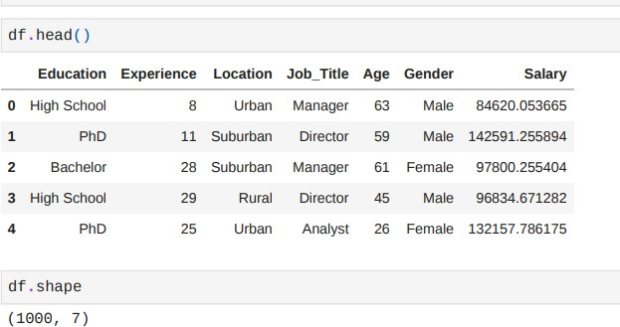
About Dataset
The "Salary Prediction Dataset" is a synthetic dataset generated for the purpose of exploring salary prediction tasks. It contains simulated data reflecting various factors influencing salary levels such as education, experience, location, job tit le, age, and gender. This dataset can be utilized for predictive modeling tasks to estimate salaries based on these factors
# Data Collection
Salary Prediction Data ,Predict the salary according to the features
(From kaggle.com)
Explore, clean and pr
epare dataset:
Check shape of original dataset:
We have total 1000 rows and 7 columns
Imported Dataset from the file.csv

Slide 7
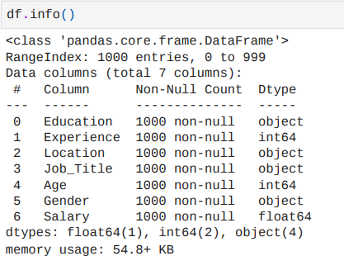
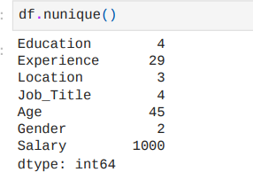
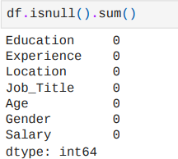
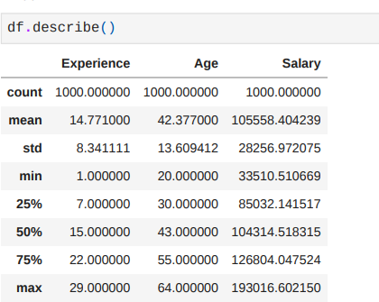

Details step of Data Exploration:
The data process involves exploration , handling info of data , unique values, duplication values in data , finding null values and describe data
which shows the total values , min , average and max values of the data.
1. Info of data 2. unique values 3.Null values
4. Data describe
5. duplicate values of data
In the data we have 0 null values and 0 duplicate values.

Slide 8
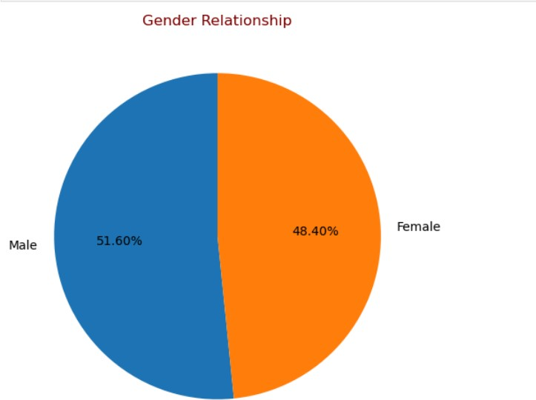
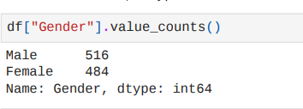
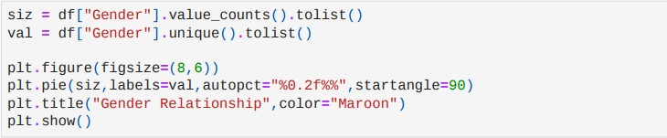
Exploratory Data Analysis (EDA):
First we plotted a pie chart to find-out gender relationship,
Here the Gender value counts.
Here the relationship of gender , male has 51.60% and women has 48.40%
#Hence proved the male has more salary then women.

Slide 9
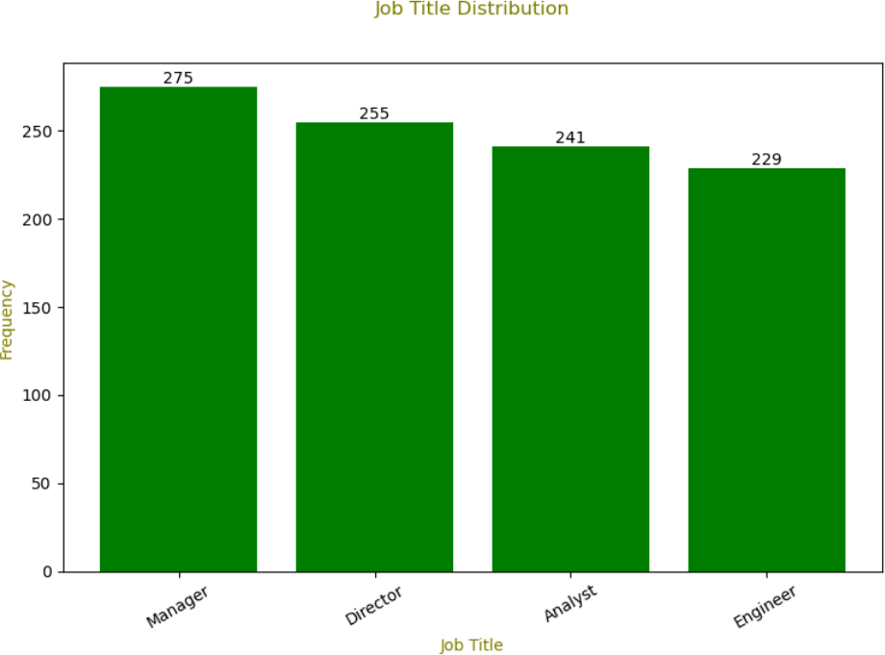
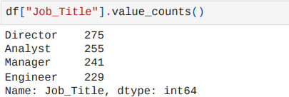
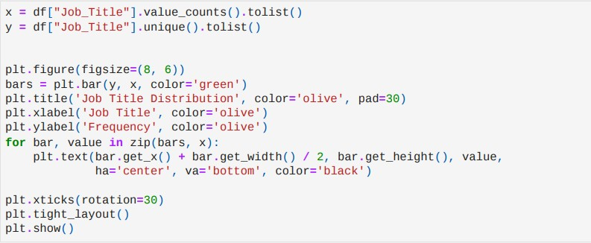
A bar plot is generated to display the “ Job Title “ Distribution to know the relationship between job title and salary.
The bar plot offering insight into the frequency of different job title.
As we can see the following bar plot the more frequency has for the manger job title and less frequency for the engineer job title.
The average frequency for the job title of director and Analyst.

Slide 10
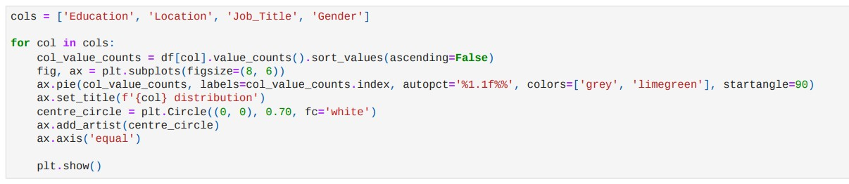
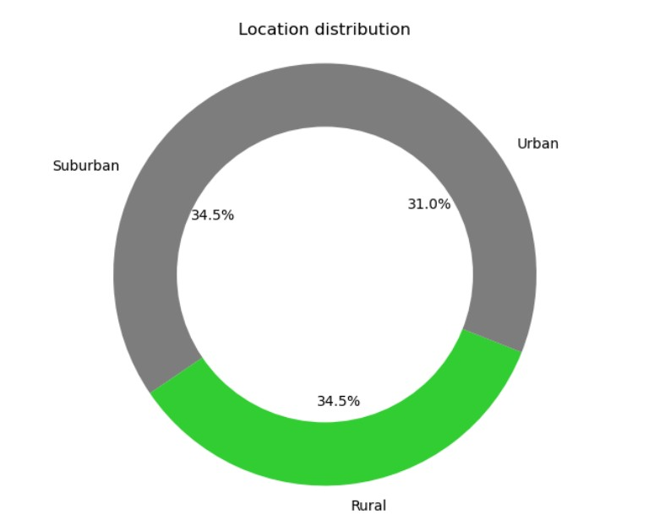
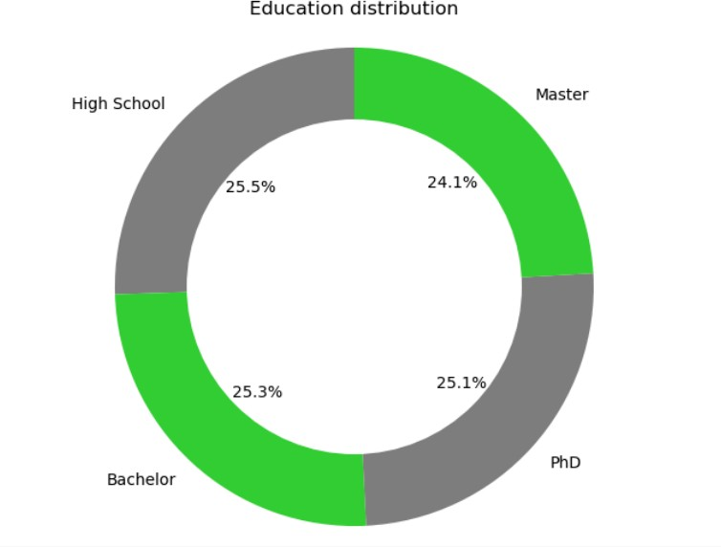
A donut chart is plotted to visualized education distribution and location distribution to finding out relationship between .
As per the education we can see the almost equal % salary but qualified from high school people have highly paid package
Location distribution chart is offering insight that
suburban and rural area people has high package.
and rural and

Slide 11

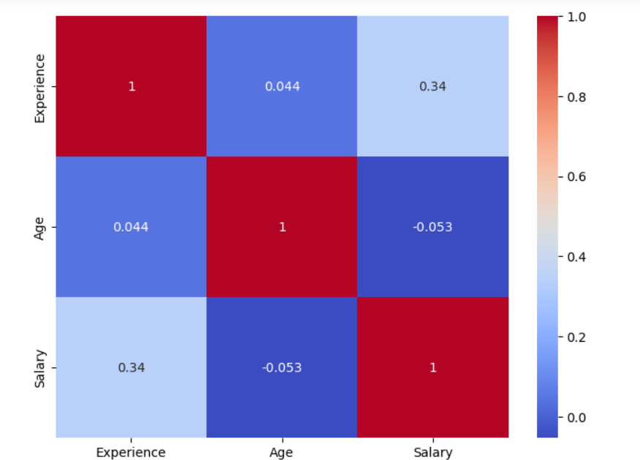

A heatmap is generated to visualize the correlation matrix of the entire dataset providing the comprehensive overview of relationship between numerical variables.
Each cell in the heatmap corresponds to the correlation coefficient between the variables represented by the row and column.
The color intensity indicates the strength and direction of the correlation:
Dark blue indicates a strong negative correlation; Dark red indicates a strong positive correlation.
White indicates no correlation (correlation coefficient close to zero).

Slide 12
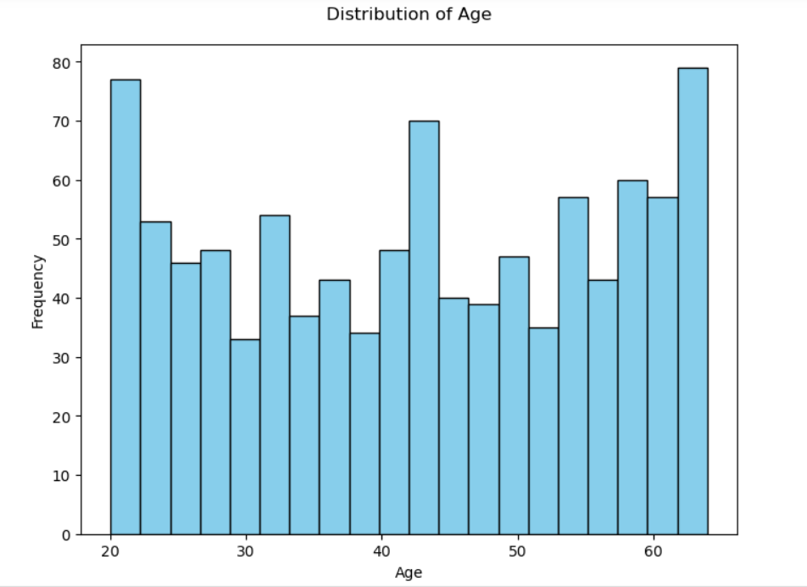
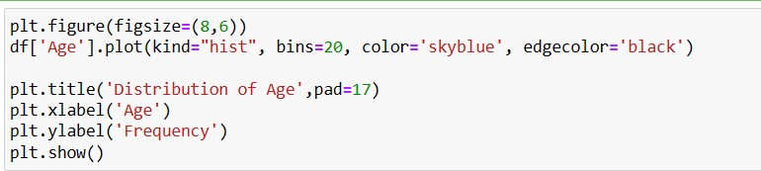
A stacked column chart is plotted for the “Age Distribution”. Offering insight into the frequency of different age type of people.
In the plot we can found that age group of between 25 to 45 have high frequency of the good salary package.
And other age group of people have average salary package
Here we can found that the middle age group of people have high salary package, and above 30 to 40 and 50 to 60 age group of people have less salary package.

Slide 13
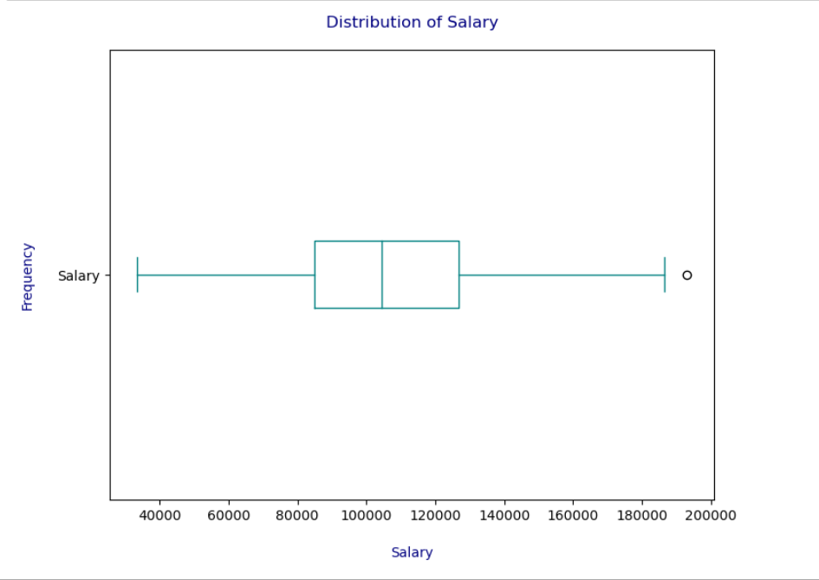
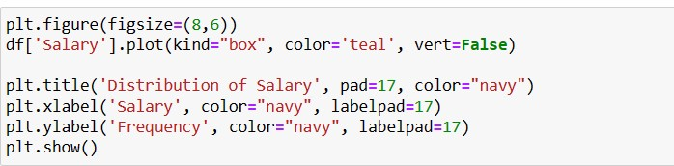
Generated a box plot to visualize the distribution of salary
Found min, median and max value of the salary package as the dataset.
We can see as per shown in the box plot min salary is 40k
Median salary package is 1.5 lakhs.
And max salary package is 1.9 lakhs.

Slide 14
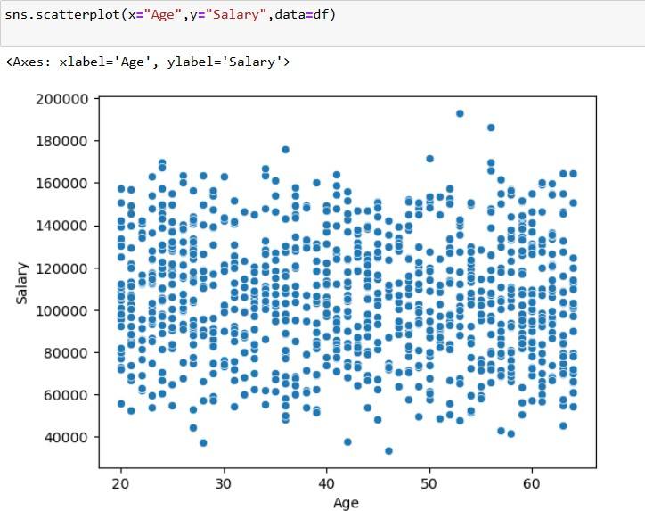
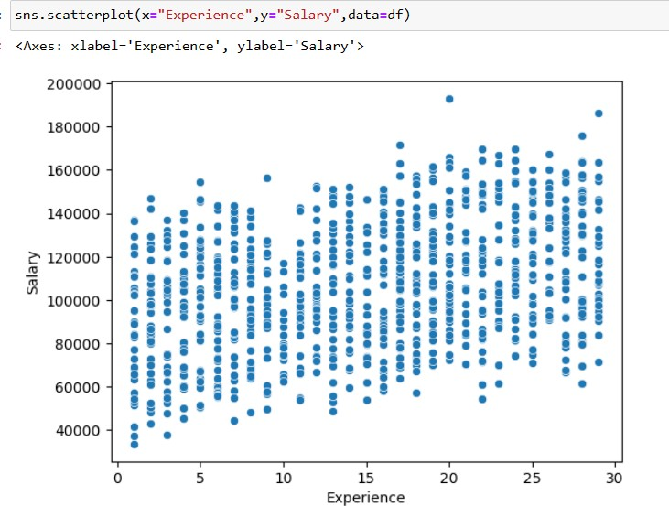
1. using scatter plot to display relationship of age and salary.
2. using scatter plot to display relationship of experience and salary.
in 1st scatter plot we can see mostly age group of people taking salary between 1 lakh to 1.2 lakh of package.
Highly experienced people less frequency and few of them only taking high salary package. which is 2 lakh
Older age group of people get lower salary package who has more experience.

Slide 15
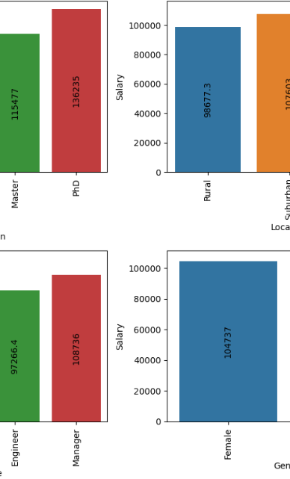
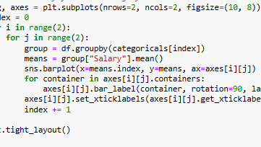
#Mean salary for each category
Generated common multiple plots to indicates mean of each category
For education category masters degree people have mean salary
In location category mean is suburban located people has mean salary.
Aa per the job title category manger job role mean salary .
Gender category has distributed the equal salary package.

Slide 16
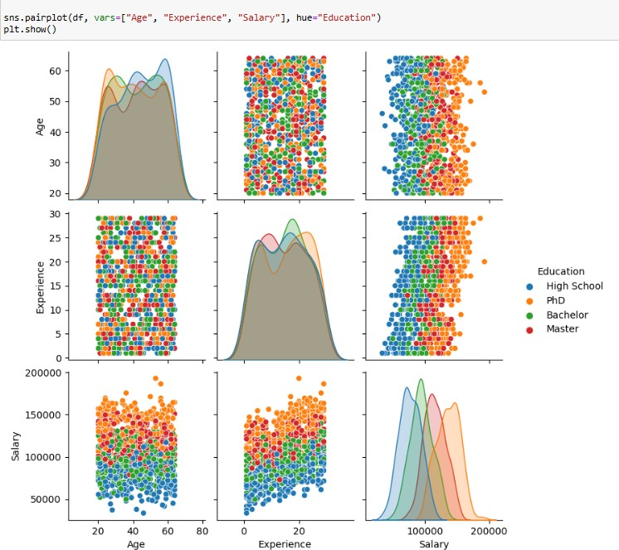
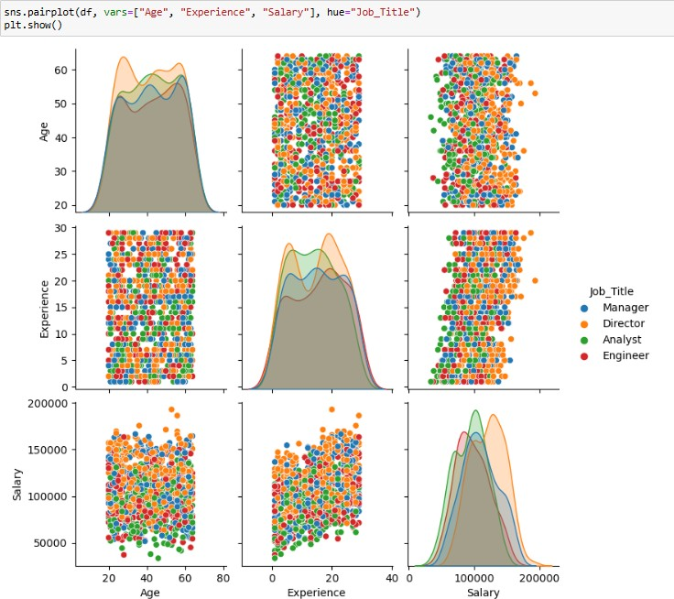
#Data distribution using pair-plots
"Age", "Experience", "Salary“, "Education“ "Age", "Experience", "Salary“ "Job Title"
pair plot visualizes the relationships between "Age", "Experience", and "Salary" for different levels of "Education". Each scatterplot in the pair plot represents the relationship between two variables, and the diagonal contains histograms showing the distribution of each variable.

Slide 17
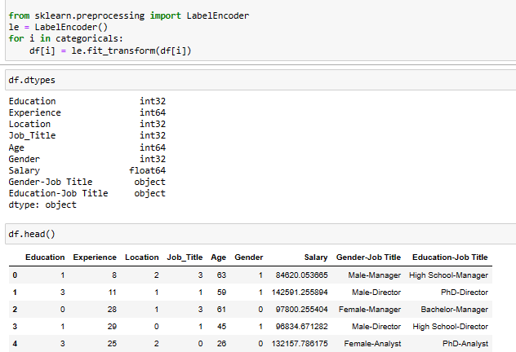
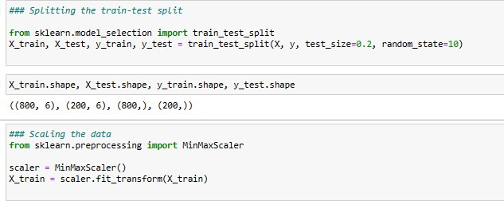
#Encoding data
Import the Label-Encoder class from scikit-learn
Iterate over each categorical variable in the list 'categorical’
found the data types of all columns in the Data Frame. There is 2 type of data : int, object.
df. head() to get information of the data of rows and columns
# Splitting the train-test split & # Scaling the data

Slide 18
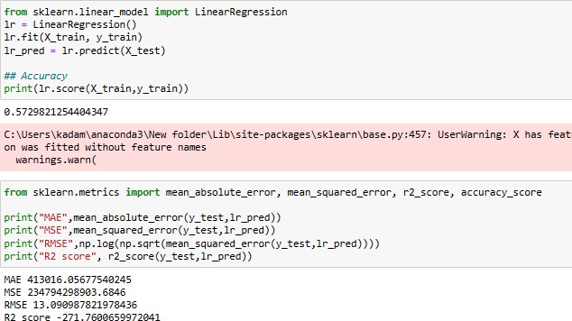
linear Regression
Using linear regression method is not suitable for my dataset, it’s showing less accuracy (0.57%)
Finding R-squared, is a statistical measure that represents the proportion of the variance in the dependent variable that is explained by the independent variables in a regression model. It is a key metric used to evaluate the goodness of fit of the model to the observed data.

Slide 19
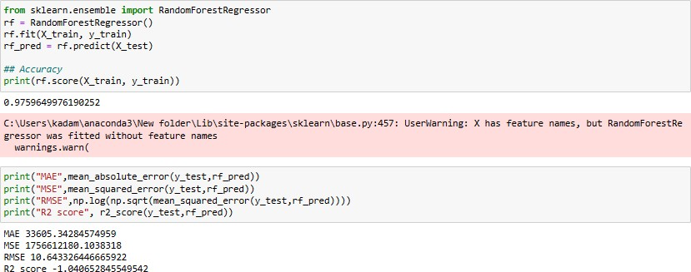
Random forest
used Random forest model for tuning hyperparameter it showing 97% accuracy.

Slide 20
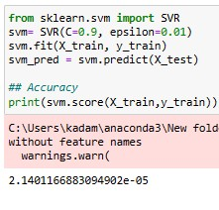
Support vector regressor
Support vector regressor provides flexible options for customizing the SVR model, including the choice of kernel function, regularization parameter, and other hyperparameters.
After using support vector regressor got 2.14% accuracy. This model is not suitable for my dataset.

Slide 21
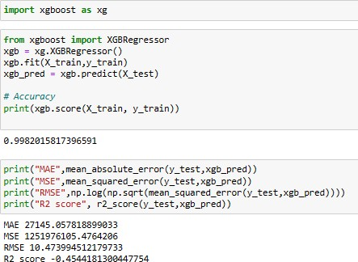
XG Boost Regressor
After applying 5 different models , getting 99% accuracy after using XGBoost Regression model so this is best model for my data set.

Slide 22
Conclusion and Insights:
Job Title
. In the second slide the bar plot indicates Each bar represents a unique job title, and the height of each bar corresponds to the frequency (count) of that job title in the dataset. The text labels on top of each bar provide the exact count for each job title categ ory. People who are working as manager position has good salary package
Education & Location
. The donut chart shows the distribution of education and location distribution The percentage labels on each slice provide additional information about the relative frequency of each category. In summary, these visualizations provide insights into the distrib ution of categorical variables in the data set. As we can see the outcome is almost same , people who studied in high school and with degree in masters have good salary package, and as we can see the location distribution rural and suburban people earning equally.
Used Heatmap for find out correlation. Insights from the Heatmap:
Strong positive correlations (values close to 1) between variables appear as bright red cells in the heatmap.
Strong negative correlations (values close to -1) between variables appear as bright blue cells in the heatmap.
Weak correlations (values close to 0) appear as cells with colors closer to white or gray.
By examining the heatmap, you can identify patterns and relationships between different numerical variables in the dataset. For example, variables with high positive correlations may indicate dependencies or interactions between them, while variables with high negative correlations may indicate inverse relationships.

Slide 23
Used Heatmap for find out correlation. Insights from the Heatmap:
Strong positive correlations (values close to 1) between variables appear as bright red cells in the heatmap.
Strong negative correlations (values close to -1) between variables appear as bright blue cells in the heatmap.
Weak correlations (values close to 0) appear as cells with colors closer to white or gray.
By examining the heatmap, you can identify patterns and relationships between different numerical variables in the dataset. For example, variables with high positive correlations may indicate dependencies or interactions between them, while variables with high negative correlations may indicate inverse relationships.

Slide 24
Application and Further Analysis:
The heatmap provides valuable insights into the relationships between variables, which can inform feature selection, model building, and data preprocessing steps in data analysis and machine learning tasks.
Further analysis can involve investigating the identified correlations in more detail, exploring causality, and validating the relationships through additional statistical tests or domain knowledge.
Histogram :
Application and Further Analysis:
The histogram provides insights into the age distribution of the dataset, which can inform demographic analysis, segmentation, and targeted marketing strategies.
Further analysis can involve comparing the age distribution across different groups or segments in the dataset, identifying outliers or anomalies, and assessing the impact of age on other variables or outcomes of interest.

Slide 25
In summary, the histogram visualization of the age distribution helps in understanding the demographic composition of the dat aset and
provides valuable insights for data-driven decision-making and analysis.
Insights from the Box Plot:
The box plot provides insights into the central tendency (median) and spread of salary values in the data set. The length of the box (IQR) indicates the spread of salary values, with longer boxes representing greater variability . The position of the median line w ithin the box indicates the central tendency of salary values. Outliers, if present, are identified as individual data points beyond the whiskers, suggesting potential extreme or unusual salary values.
In box plot min salary is 40k and the median is 1.10 lakh and the max is 1.90 lakh.

Slide 26
Scatter plot
the scatter plot visualization of the age-salary relationship provides insights into the patterns and variability in the dataset, facilitating data exploration and analysis for salary prediction or related tasks.
We found the relationship of age and salary as the age increases the salary package is getting less, and the 20 to 40 age group of people has average salary package but the frequency is high . Highly experienced people less frequency and few of them only taking high salary package. which is 2 lakh.
Mean salary for each category
Insights from the Bar Plots:
The height of each bar indicates the average salary for the corresponding category.
By comparing the heights of bars within each plot, you can identify variations in mean salary across different categories within the same categorical variable.
Differences in mean salary between categories may suggest potential factors influencing salary variations within the dataset.
Model used:
Used all this model ( linear Regression , Random forest ,Ada boost regressor , Support vector regressor , XG Boost Regressor) to get accuracy of dataset and After applying 5 different models , getting 99% accuracy after using XG Boost Regression model so this is best model for my data set.

Slide 27


